Slide 1

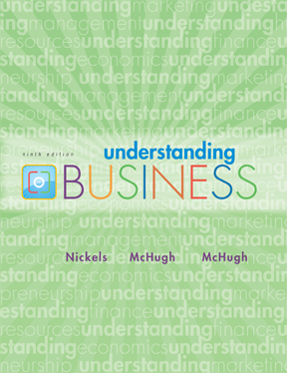
*
Chapter Eleven
*
Human Resource Management: Finding and Keeping the Best Employees
McGraw-Hill/Irwin
Copyright © 2010 by the McGraw-Hill Companies, Inc. All rights reserved.

Slide 2
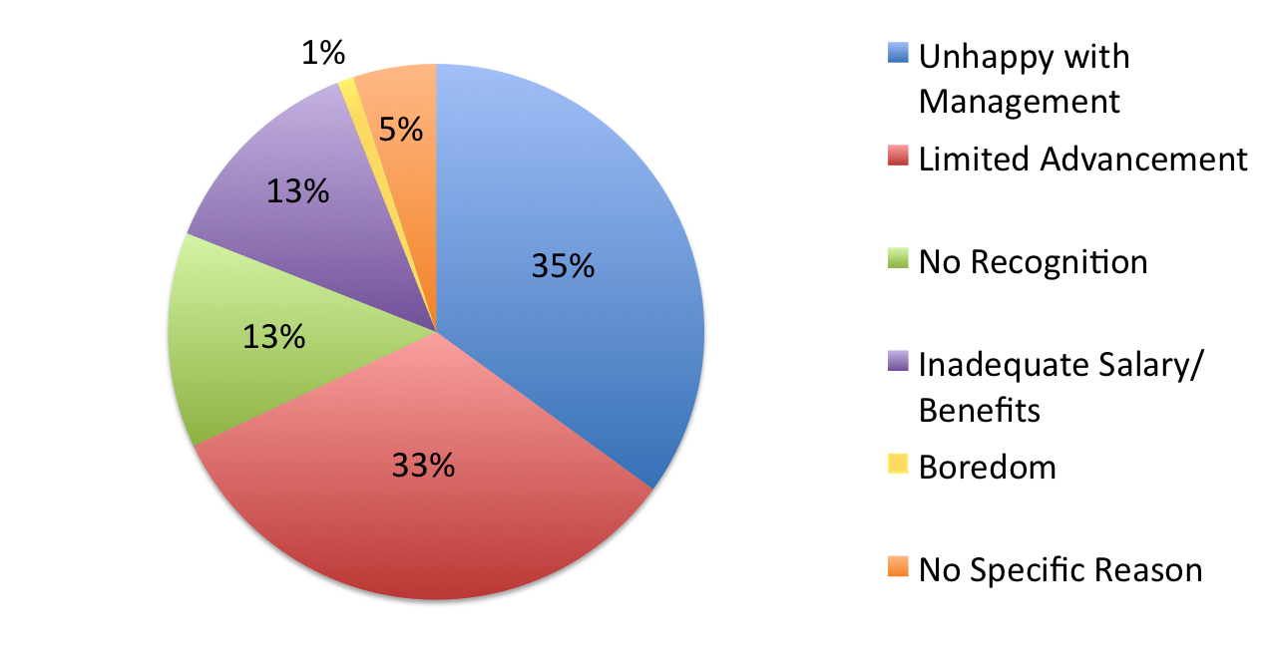
WHY GOOD EMPLOYEES QUIT
*
Management Development
*
LG6
Source: Robert Half International
11-2
Notes:
See Learning Goal 6: Illustrate employee training and development methods.
Why Good Employees Quit
This slide presents some of the reasons why good employees quit.
Ask the students: Why is it important for managers to understand why employees leave a company? (It translates directly into the bottom line of the organization. The higher the turnover, the higher the costs for recruiting, selecting, training and development, etc.)
Ask the students: What are other reasons why employee retention is important? (Some other reasons may be morale of the workers, ability to recruit, reputation and image of the company, etc.)
Ask the students: Would you like to work at a place that feels like it has a revolving door?

Slide 3
USING NETWORKS and MENTORING
*
Networking
*
LG6
Networking -- Establishing and maintaining contacts with key managers in and out of the organization and using those contacts to develop relationships.
Networking goes beyond the work environment.
11-3
Notes:
See Learning Goal 6: Illustrate employee training and development methods.
Many students are familiar with social networking but are unfamiliar with career networking. Ask the students: How can you use sites like Facebook, YouTube, and Twitter to establish and maintain contacts with key managers in and out of the organization?

Slide 4

APPRAISING PERFORMANCE on the JOB
*
Appraising Employee Performance to Get Optimum Results
*
LG7
Performance Appraisal -- An evaluation that measures employee performance against established standards in order to make decisions about promotions, compensation, training or termination.
A 360-degree review gives managers opinions from people at different levels to get a more accurate idea of the worker’s ability.
11-4
Notes:
See Learning Goal 7: Trace the six steps in appraising employee compensation programs.

Slide 5
SIX STEPS of PERFORMANCE APPRAISALS
*
Appraising Employee Performance to Get Optimum Results
*
LG7
Establishing performance standards that are understandable, measurable and reasonable.
Clearly communicating those standards.
Evaluating performance against the standards.
Discussing the results with employees.
Taking corrective action.
Using the results to make decisions.
11-5
Notes:
See Learning Goal 7: Trace the six steps in appraising employee compensation programs.

Slide 6
MAJOR USES of PERFORMANCE APPRAISALS
*
Appraising Employee Performance to Get Optimum Results
*
LG7
Identify training needs
Use as a promotion tool
Recognize worker’s achievements
Evaluate the firm’s hiring process
Judge the effectiveness of the firm’s orientation process
Use as a basis for possible termination of a worker
11-6
Notes:
See Learning Goal 7: Trace the six steps in appraising employee compensation programs.
Major Uses of Performance Appraisals
This slide gives students insight as to the importance of regular performance appraisals.
To start a discussion on performance appraisals ask students to discuss the 360-degree review.
After the discussion use the next slide to walk students through some of the problems associated with performance appraisals.

Slide 7
PERFORMANCE APPRAISAL MISTAKES Common Problems Made While Reviewing Employees
*
Appraising Employee Performance to Get Optimum Results
*
LG7
Contrast Effect - Comparing one employee to another.
Halo/Horn Effect - Allowing performances in specific areas to unfairly influence overall performance evaluation.
Similar-to-Me Effect - Generosity to those you feel are more like you.
11-7
Notes:
See Learning Goal 7: Trace the six steps in appraising employee compensation programs.
Performance Appraisal Mistakes
This slide highlights some of the problems made while reviewing employees.
Ask the students: How can managers avoid some of the issues discussed in this slide?
To start a discussion about performance appraisals and teams ask students: Do you think it is fair to have your own performance appraised based on the work of others on your team?

Slide 8
PROGRESS ASSESSMENT
*
Progress Assessment
*
Name and describe four training techniques.
What’s the primary purpose of a performance appraisal?
What are the six steps in a performance appraisal?
11-8
Notes:
Name and describe four training techniques. Off-the-job training occurs away from the workplace and consists of internal or external programs to develop any of a variety of skills or to foster personal development. An apprenticeship program involves a student or apprentice working alongside an experienced employee to master the skills and procedures of a craft. Vestibule training or near-the-job training is done in a classroom with equipment similar to that used on the job so employees learn proper methods and safety procedures before assuming a specific job assignment. Job simulation is the use of equipment that duplicates job conditions and tasks so trainees can learn skills before attempting them on the job.
What’s the primary purpose of a performance appraisal? The primary purpose of a performance appraisal is to determine whether workers are doing an effective and efficient job, with a minimum of errors and disruptions.
What are the six steps in a performance appraisal? (1) Establishing performance standards, (2) communicating those standards, (3) evaluating performance, (4) discussing results with employees, (5) taking corrective action, and (6) using the results to make decisions.

Slide 9
COMPENSATION PROGRAMS
*
Compensating Employees: Attracting and Keeping the Best
*
LG8
A managed and competitive compensation program helps:
Attract the kinds of employees the business needs.
Build employee incentive to work efficiently and productively.
Keep valued employees from going to competitors or starting their own firm.
Maintain a competitive market position by keeping costs low due to high productivity from a satisfied workforce.
Provide employee financial security through wages and fringe benefits.
11-9
Notes:
See Learning Goal 8: Summarize the objectives of employee compensation programs, and evaluate pay systems and fringe benefits.

Slide 10

TYPES of PAY SYSTEMS
*
Pay Systems
*
LG8
Salary
Hourly Wage/Day Work
Piecework System
Commission Plans
Bonus Plans
Profit Sharing Plans
Gain-Sharing Plans
Stock Options
11-10
Notes:
See Learning Goal 8: Summarize the objectives of employee compensation programs, and evaluate pay systems and fringe benefits.
Students should be aware when accepting a job offer to consider not just the salary but the entire compensation package.

Slide 11


COMPENSATING TEAMS
*
Compensating Teams
*
LG8
Team-based pay programs are more challenging than individual pay systems.
The two most common methods for teams involve:
Skill-Based: Pay is increased as team members learn and apply new skills.
Gain-Sharing: Pay is increased as improvement over previous performance.
11-11
Notes:
See Learning Goal 8: Summarize the objectives of employee compensation programs, and evaluate pay systems and fringe benefits.
Skill-based pay is increased when teams learn and apply new skills. Gain sharing bases team bonuses on improvements over previous performance.

Slide 12
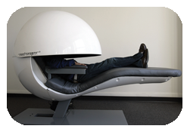
FRINGE BENEFITS on the JOB
*
Fringe Benefits
*
LG8
Fringe Benefits -- Sick leave, vacation pay, pension and health plans that provide additional compensation to employees beyond base wages.
In 1929, Fringe benefits accounted for less than 2% of payroll cost. Today it’s about 30%.
Healthcare has been the most significant increase in fringe benefit cost.
11-12
Notes:
See Learning Goal 8: Summarize the objectives of employee compensation programs, and evaluate pay systems and fringe benefits.
The rising cost of healthcare and the cost of employer provided health insurance is unsustainable in the long term. This requires both management and employees to create systems that keep cost down, but still provide meaningful coverage. This could include employee wellness programs and/or higher deductibles.

Slide 13

The RANGE of FRINGE BENEFITS
*
Fringe Benefits
*
LG8
Fringe benefits include incentives like:
Company cars
Country club memberships
Recreation facilities
Special home mortgage rates
Paid and unpaid sabbaticals
Day-care and elder care services
Dental and eye care
Legal counseling
Short or compressed work weeks
11-13
Notes:
See Learning Goal 8: Summarize the objectives of employee compensation programs, and evaluate pay systems and fringe benefits.

Slide 14

CAFETERIA-STYLE and SOFT BENEFITS
*
Fringe Benefits
*
LG8
Cafeteria-Style Fringe Benefits -- Allow employees to choose the benefits they want (up to a certain dollar amount).
Soft Benefits include:
Onsite haircuts and shoe repair
Concierge services
Free meals at work
Doggie daycare
Onsite farmer’s markets
11-14
Notes:
See Learning Goal 8: Summarize the objectives of employee compensation programs, and evaluate pay systems and fringe benefits.
The name of the game today regarding employee benefits is creativity!

Slide 15
CHANGING TIMES, CHANGING EMPLOYEE BENEFITS
*
Fringe Benefits
*
LG8
Employer Benefits | 1998 | 2008
Provide Pension Plans | 48% | 29%
Offer Wellness Programs | 51% | 60%
Retirement Plan Contribution | 91% | 81%
Permit Some Flexible Work Hours | 68% | 80%
Source: National Study of Emplyees (2008), Family & Work Institute.
11-15
Notes:
See Learning Goal 8: Summarize the objectives of employee compensation programs, and evaluate pay systems and fringe benefits.
Changing Times
This slide shows how employees have moved away from monetary based employee benefits to non-monetary based employee benefits.
Discuss with students the implication of this trend.
Ask the students: Why has this shift occurred? (Answers will vary but will should include competition and globalization.)

Slide 16
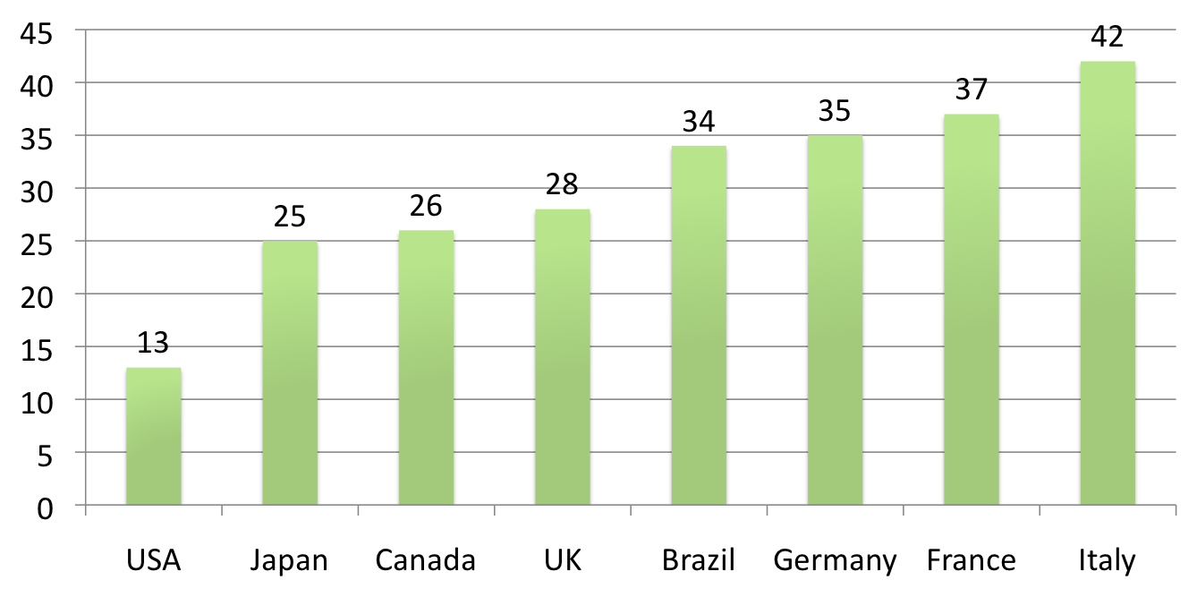
LET’S GO to the BEACH! Average Vacation Days by Country
*
Fringe Benefits
*
LG8
11-16
Notes:
See Learning Goal 8: Summarize the objectives of employee compensation programs, and evaluate pay systems and fringe benefits.
Vacation Days Per Year
This slide presents a comparison of number of vacation days per year in different countries.
Italy leads with an average of 42 vacation days per year where as the U.S. comes in last with just 13 days.
Even though the U.S. comes in last with only 13 days, an interesting fact to share with the students is that most American don’t even use these 13 days.
Ask the students: What impact does this benefit of number of days of vacation have on recruiting at an international level? (Most should be able to identify that domestically, it may not have much of an impact. However internationally, potential candidates would be comparing between different countries. Especially if they are from one of the ones that offer a much higher number of vacation days, such as Italy, France, or Germany. This may have an impact on the ability of an organization to recruit.)

Slide 17

WORKING WORLDWIDE (Reaching Beyond Our Borders)
*
*
Managers need to understand the business needs of each country they operate in.
Compensation: Conversion to foreign currencies and special allowances often are needed.
Health and Pension Standards: Benefits are different country-by-country.
Paid Time Off: Vacation time, sick and personal leave vary.
Taxation: Tax policies vary.
Communication: Employees can feel disconnected in other countries.
11-17
Notes:
See Learning Goal 8: Summarize the objectives of employee compensation programs, and evaluate pay systems and fringe benefits.

Slide 18
FLEXIBLE SCHEDULING PLANS
*
Scheduling Employees to Meet Organizational and Employee Needs
*
LG9
Flextime Plan -- Gives employees some freedom to choose which hours to work as long as they work the required number.
Compressed Work Week -- Employees work the full number of work hours, but in fewer than the standard number of days.
Job Sharing -- Lets two or more part-time employees share on a full-time job.
11-18
Notes:
See Learning Goal 9: Show how managers use scheduling plans to adapt to workers’ needs.

Slide 19
USING FLEXTIME PLANS
*
Flextime Plans
*
LG9
Most flextime plans require Core Time -- When all employees are expected to be at their job stations.
Flextime is hard to incorporate into shift work and managers have to work longer hours.
Communication among employees can also be difficult under flextime and managers have to be alert to any system abuses.
11-19
Notes:
See Learning Goal 9: Show how managers use scheduling plans to adapt to workers’ needs.

Slide 20
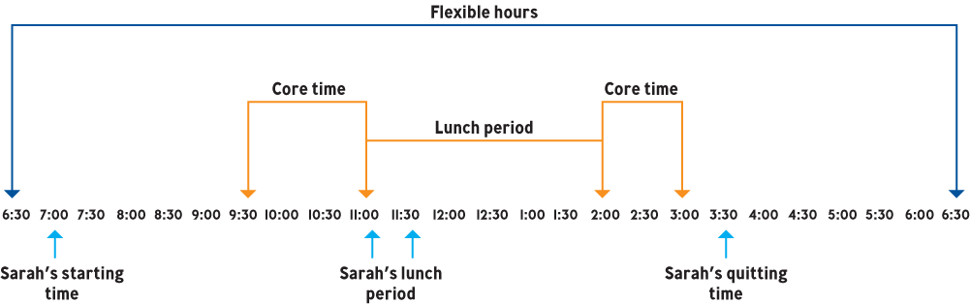
A FLEXTIME CHART
*
Flextime Plans
*
LG9
11-20
Notes:
See Learning Goal 9: Show how managers use scheduling plans to adapt to workers’ needs.
Flextime gives employees some freedom and empowers them to work when it best meets their schedule. The benefits are obvious and often lead to a more motivated workforce.

Slide 21

COMPRESSED WORK WEEKS
*
Flextime Plans
*
LG9
Employees enjoy long weekends after working long days.
Productivity is a concern.
Nurses and firefighters often work compressed work weeks.
11-21
Notes:
See Learning Goal 9: Show how managers use scheduling plans to adapt to workers’ needs.

Slide 22
JOB SHARING BENEFITS
*
Job Sharing Plans
*
LG9
Provides employment opportunities for many people who cannot work full time.
Workers tend to be enthusiastic and productive.
Absenteeism and tardiness are reduced.
Employers can schedule part-time workers in peak demand periods.
11-22
Notes:
See Learning Goal 9: Show how managers use scheduling plans to adapt to workers’ needs.

Slide 23
PROGRESS ASSESSMENT
*
Progress Assessment
*
Name and describe five alternative compensation techniques.
What advantages do compensation plans such as profit sharing offer an organization?
What are the benefits and challenges of flextime? Telecommuting? Job sharing?
11-23
Notes:
Name and describe five alternative compensation techniques. Commission Plans - rewarding employees with a percentage of sales. Bonus Plans - rewarding employees with payment based on achievement of a predetermined goal. Profit Sharing Plans - giving employees the ability to share in a percentage of the company’s profit. Gain-Sharing Plans - bonus is based on improvements over previous performance. Stock Options - granting employees shares of stocks based on performance.
What advantages do compensation plans such as profit sharing offer an organization? The hope is that profit sharing plans will motivate employees to think like owners.
What are the benefits and challenges of flextime? Telecommuting? Job sharing? Flextime benefits include allowing employees to adjust to work/life demands. Challenges of flextime include not being applicable for all businesses, making communication more difficult, and creating the possibility of resentment if employees abuse the system. Telecommuting benefits include cost saving for employers and allows employees to manage work/life demands. Challenges of telecommuting includes that it requires disciplined employees to stay focused and communication with employees may suffer. Job sharing benefits include employment opportunities for those who cannot (or prefer not to) work full-time, reduced absenteeism and tardiness, retention of experienced workers and ability to schedule workers during peak times. Challenges of job sharing include the need to hire, train, motivate, and supervise at least twice as many employees.

